Slide 1
BIA- 678 Twitter Sentiment Analysis using Spark
Shikuan Gao
Rhutvij Savant

Slide 2
Introduction
Twitter has become a wealth of data for those trying to understand how people feel about brands, topics, and more.
Mining twitter data for insights is one of the most common natural language processing tasks.
Analyze tweets makes it simple to understand what people think positively or negatively about a certain keyword.
Analyze tweets is especially valuable when there is a large amount of tweets around a subject.

Slide 3
Objective
The goal is to predict the twitter sentiments whether is positive or negative.
The objective of this project is to show how sentimental analysis can help improve the user experience over a social network or system interface.

Slide 4
Data Source
The dataset for training the model is from "Sentiment140", a dataset originated from Stanford University.
http://cs.stanford.edu/people/alecmgo/trainingandtestdata.zip

Slide 5
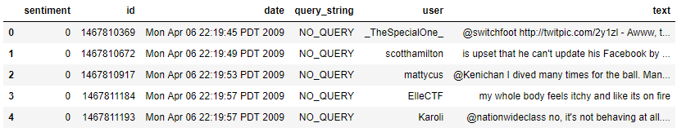
Format of Data
1.6 million observations
Data file format has 6 fields:
the polarity of the tweet (0 = negative, 4 = positive)
the id of the tweet (1467810369)
the date of the tweet Mon Apr 06 22:19:45 PDT 2009)
the query. If there is no query, then this value is NO_QUERY.
the user that tweeted (mattycus)
the text of the tweet

Slide 6
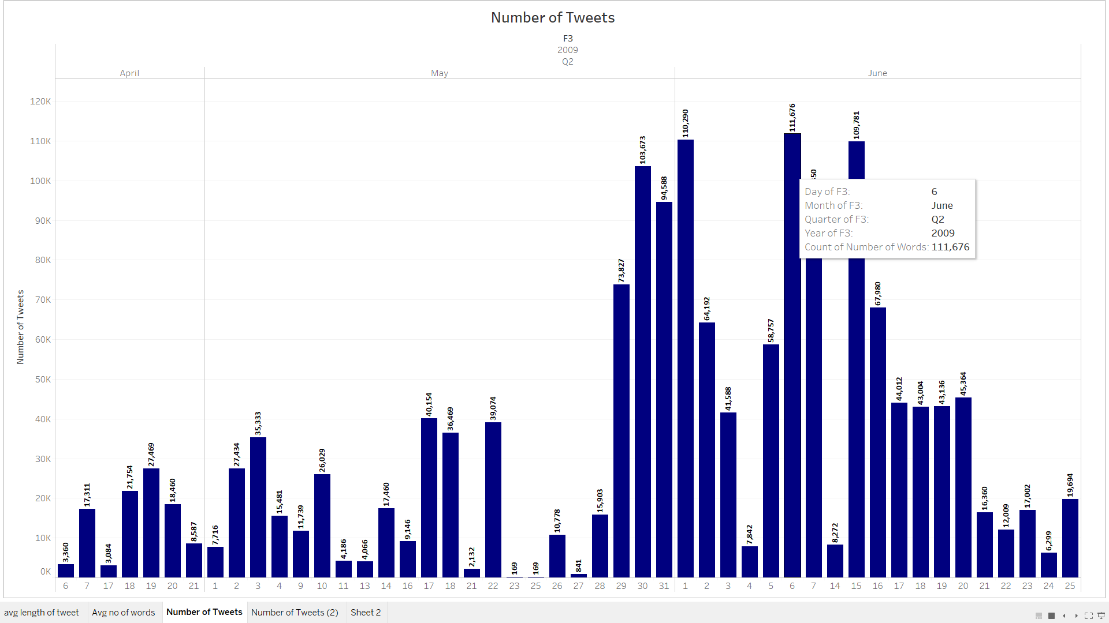
Exploratory Data Analysis
Analysis of Total Number of Tweets: 1.6 million tweets and about 660,000 users

Slide 7
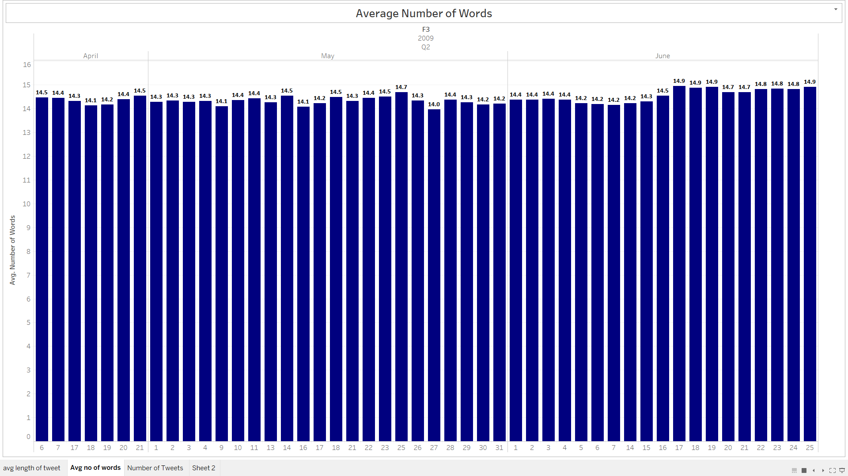
Exploratory Data Analysis: Number of Words Per Tweet
The chart below is an analysis of average number of words for each of the tweets
On average the users type 14 to 15 words per tweet

Slide 8
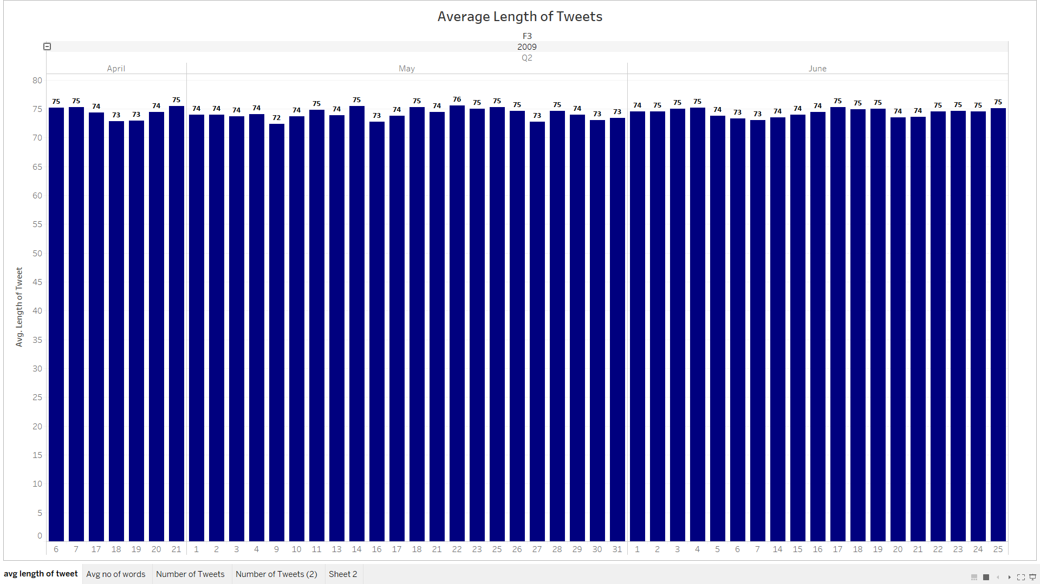
Exploratory Data Analysis: Length of the Tweets
The chart below is an analysis of average number of characters used or length of the tweet
On average there are 70 to 75 characters used in each tweet

Slide 9
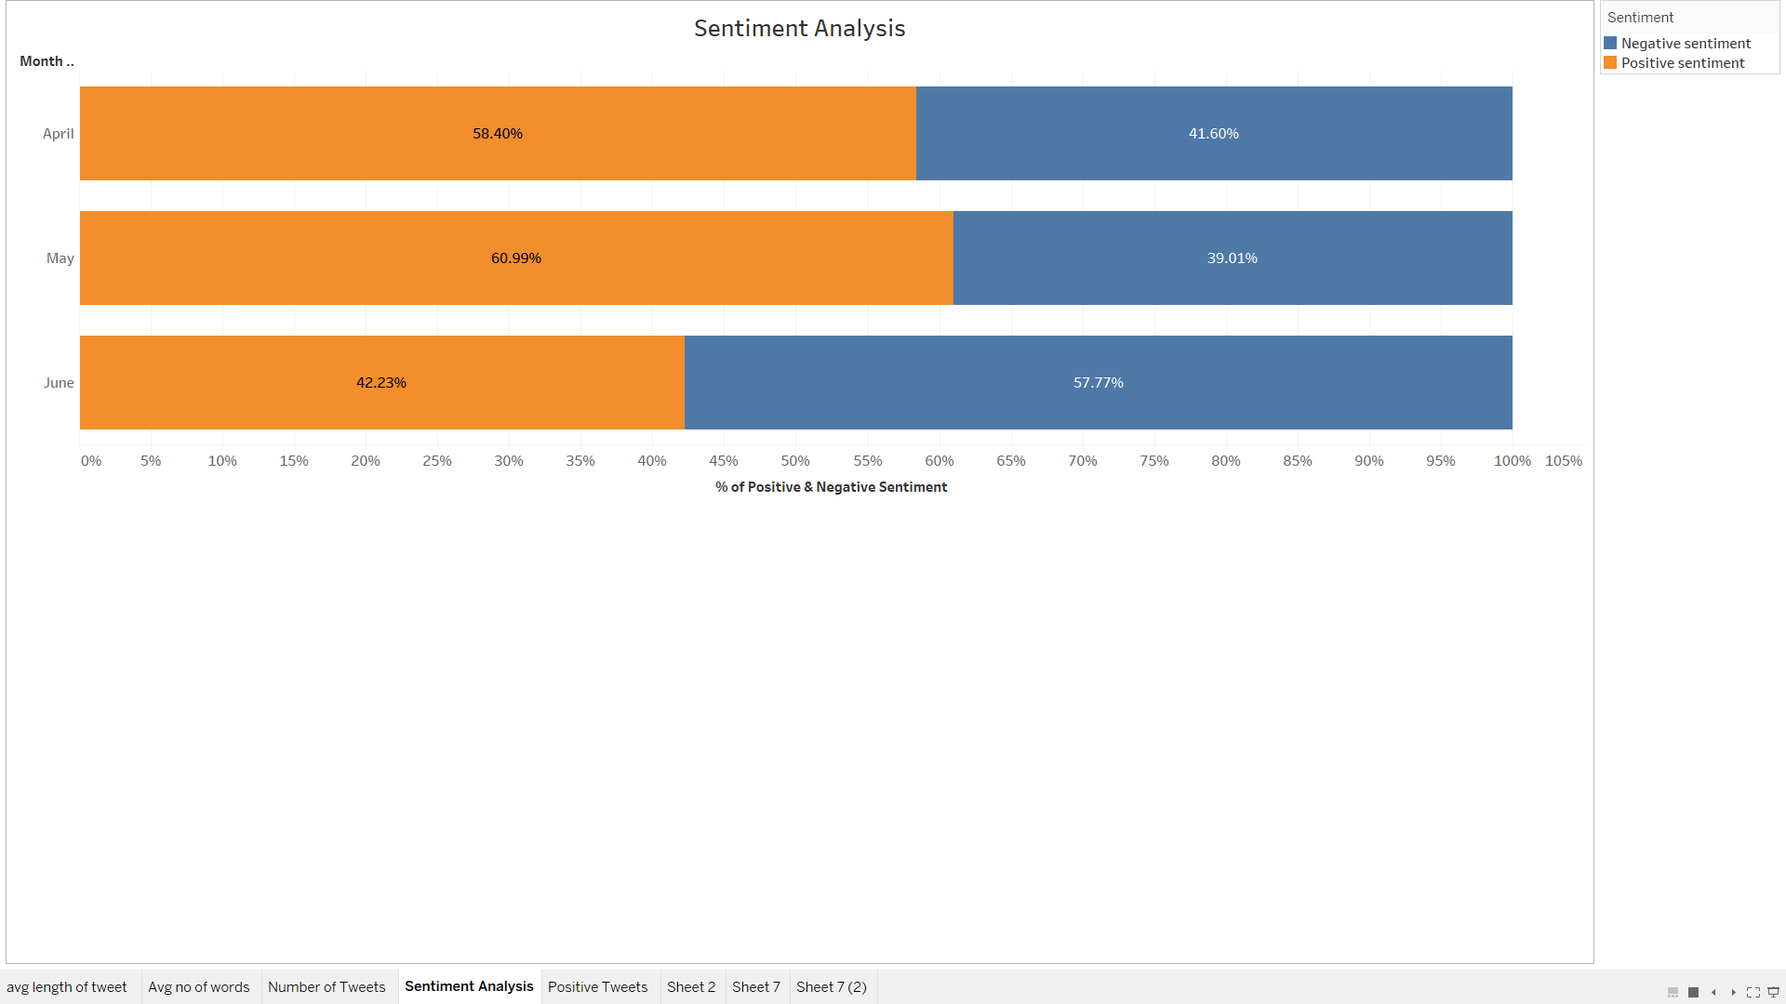
Exploratory Data Analysis: Positive & Negative sentiment
The analysis of positive and negative tweet sentiment
It describes the percent of tweets that are positive and negative in a month and can be expanded to a daily analysis.

Slide 10
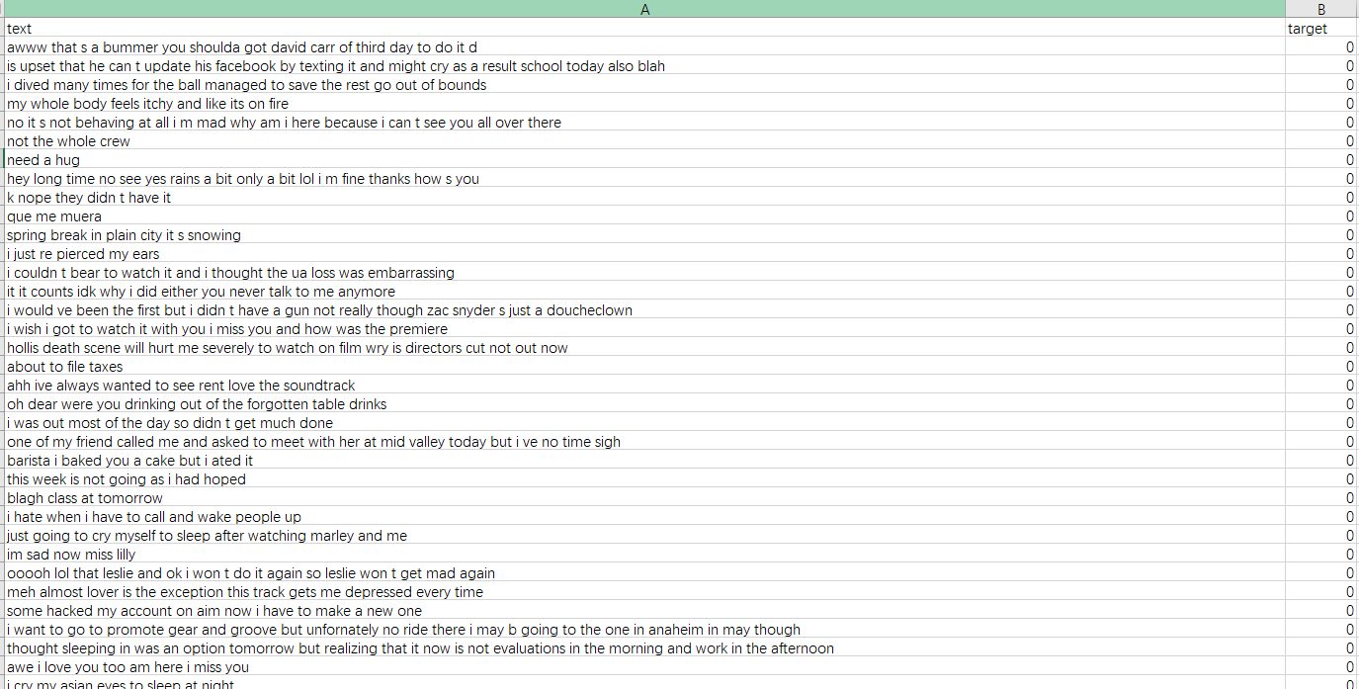
Data Cleaning
After:
HTML decoding
@mention
URL links
hashtag / numbers

Slide 11
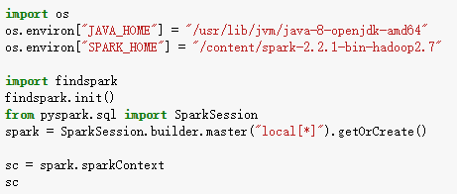
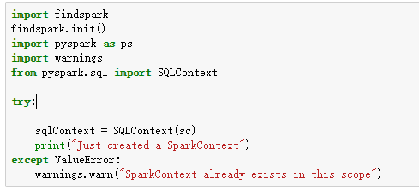
Initial Spark
PySpark is the Python API for Spark
Creating Spark Context
One of the contents in Pyspark package
Main entry point for Spark functionality

Slide 12
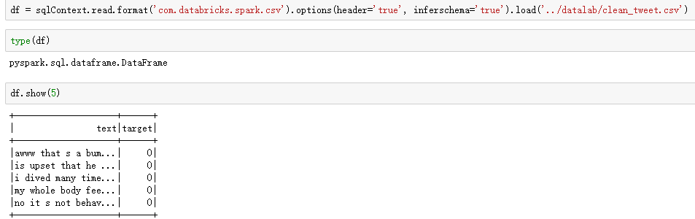
Initial Spark
Loading the Dataframe in Spark context

Slide 13
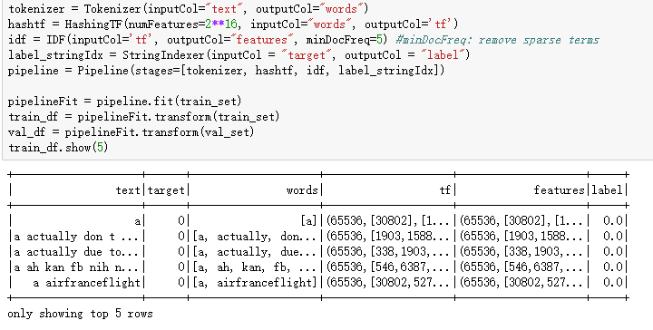
Tokenization and Term Frequency
Tokenizer splits text into tokens. These tokens could be paragraphs, sentences or individual words. Here, we are tokenizing into words.
frequency inverse term frequency is a feature vectorization method widely used in text mining to reflect the importance of a term to a document in the corpus.

Slide 14


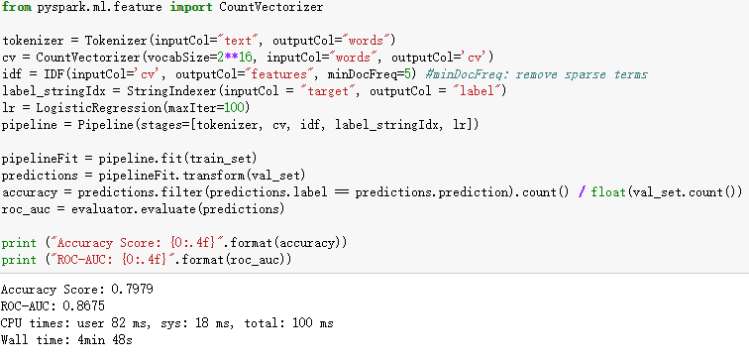
Results & Performance Measurements

Slide 15
Conclusion
Sentiment analysis can be used on social media big data to gain valuable business insights for various media and finance companies
There are millions of tweets each day and a large amont of data is generated. Spark can be used for implementation of sentiment analysis projects with better performance.
The analysis of such user sentiment can be used to make key business decisions and future strategies.

Slide 16
Thank you

